Slide 1
Teachers Teach Teachers:
Physics Professional Development for Elementary In-Service Teachers in an Urban District
Katya Denisova
Baltimore City Public Schools

Slide 2
NSF Math and Science Targeted Partnership
A program of the National Science Foundation
Leverage university expertise to improve K-12 STEM outcomes
Community Enterprise for STEM Learning
Expand the composition of partnerships in order to integrate necessary supports for students so they can learn mathematics, science, engineering, and/or computer science. This involves attentiveness to aspects of their lives that reach beyond the school setting.
$7.4 million over 6 years

Slide 3
SABES Goal
Target 3rd - 5th grade students and families in three high-need, urban neighborhoods and seek to improve STEM literacy by comprehensively engaging the community in STEM learning practices.
Address three clear needs
Need for increased student achievement in STEM
Need for professional development of teachers within a learning community
Need for broad participation throughout the community

Slide 4
SABES Components
In-school:
(I) NGSS –aligned curriculum for grades 3-5 with adaptations for ELL students and students with special needs
(II) STEM content academies for teachers
(III) Instructional Coaching
(IV) Peer-Learning community for teachers with peer visits
After-school:
(I) STEM-focused, less-rigid curriculum from NPASS2 and Engineering Adventures
(II) Year-long mentoring programs
Community:
(I) Annual STEM Showcases
(II) Meetings with community partners
STEM Achievement in Baltimore Elementary Schools is supported by the National Science Foundation under Grant No. DUE-1237992

Slide 5
SABES Components
In-school:
(I) NGSS –driven curriculum for grades 3-5 with adaptations for ELL students and students with special needs
(II) STEM content Academies for teachers
(III) Instructional Coaching
(IV) Peer-Learning community for teachers with peer visits
After-school:
(I) STEM-focused, less-rigid curriculum from NPASS2* and Engineering Adventures**
(II) Year-long mentoring programs
Community:
(I) Annual STEM Showcases
(II) Meetings with community partners
STEM Achievement in Baltimore Elementary Schools is supported by the National Science Foundation under Grant No. DUE-1237992

Slide 6
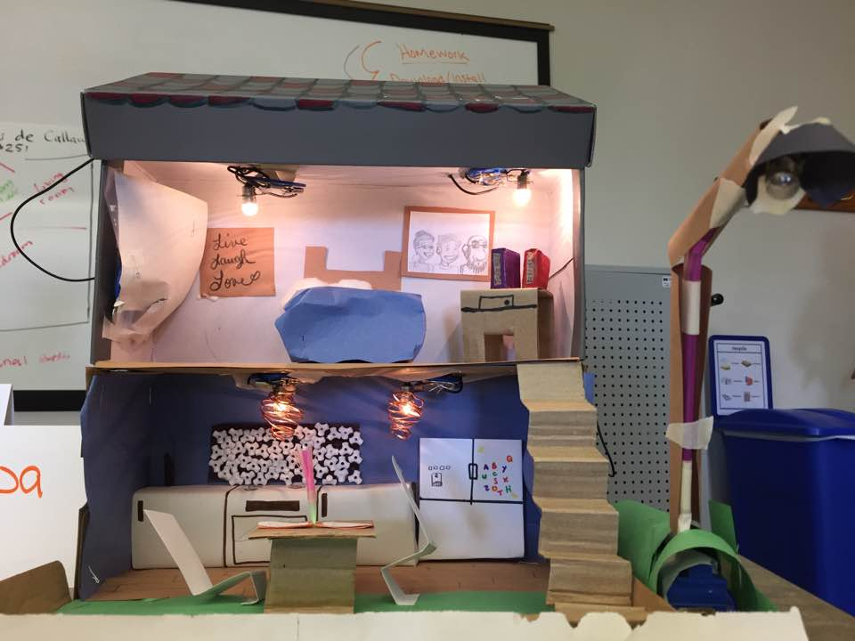
Teacher PD: STEM Academies
Physical Science
STEM Academy
Advancing Elementary
STEM Teacher Identity
Through Mentoring

Slide 7
Data Sample (2013-2016): How comfortable are you teaching these topics?

Slide 8
Questions? Comments?
Please email
Katya Denisova at
eddenisova@bcps.k12.md.us
Notes:
All are significant at the 0.05 level of confidence

